Slide 1
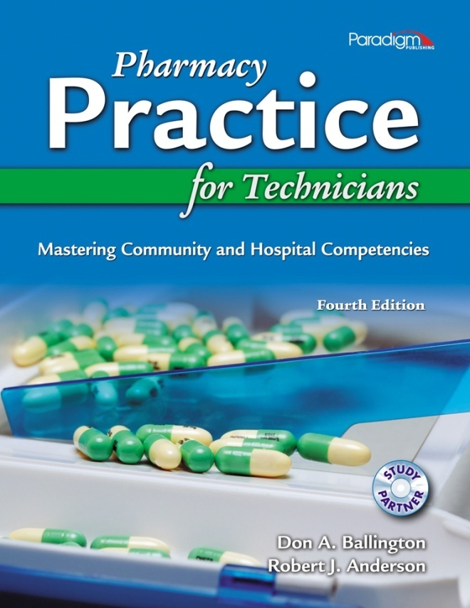
Chapter 1
The Profession
of Pharmacy

Slide 2
Origins of Pharmacy Practice
Ancient Egyptians compiled lists of drugs known as
Formularies
Dispensatories
Pharmacopeias
Beginning of an empirical approach to medicine

Slide 3
Origins of Pharmacy Practice
Greeks first took a scientific approach to medicine.
Pharmacy comes from the ancient Greek pharmakon, meaning
Drug
Remedy

Slide 4
Origins of Pharmacy Practice
Hippocrates
“Father of medicine”
Believed illness was physical rather than spiritual
Used scientific principles to
Identify disease
Determine the cause of disease
Treat disease

Slide 5
Origins of Pharmacy Practice
Galen, Greek physician (130 – 200 A.D.)
“Father of pharmacy”
Organized six centuries of knowledge
Conducted animal experiments
Produced classification of drugs

Slide 6
Origins of Pharmacy Practice
Pharmacy practice evolved in the Middle Ages
Persian Empire
Introduced dosage formulation
Identified pharmacist as health professional
Western Europe
Developed apothecary concept
Created professional guilds for pharmacy training

Slide 7
Origins of Pharmacy Practice
European Renaissance
(1350 – 1650 A.D.)
Rise of alchemy
Emergence of science and publishing
Rudimentary testing and research
Major cities developed own drug lists
Apothecaries still run by physicians

Slide 8
Origins of Pharmacy Practice
Pharmacy in the U.S. followed European model.
Professions of physician and pharmacist eventually separated.
The U.S. developed its own pharmacopeia in 1820.

Slide 9
Pharmacy Workplace
Community Pharmacies
Institutional Pharmacies

Slide 10
Community Pharmacies
60% of U.S. pharmacists work in community (or retail) pharmacies
Many types of community pharmacies
Chain
Independent
Compounding
Franchise
Mail-order

Slide 11
Terms to Remember
community pharmacy
any independent, chain, or franchise pharmacy that dispenses prescription medications to outpatients; also called a retail pharmacy

Slide 12
Community Pharmacies
Chain pharmacy
High-volume locations
Department store (Target, Wal-Mart)
Grocery store (Kroger, Publix)
Drugstore (Walgreens, CVS, Rite-Aid)
Heavy use of pharmacy technicians and automation

Slide 13
Terms to Remember
chain pharmacy
a community pharmacy that consists of several similar pharmacies in the region (or nation) that are corporately owned

Slide 14
Community Pharmacies
Independent pharmacy
Owned and operated by one or a group of pharmacists or entrepreneurs
Compounding pharmacy
Specializes in preparations that are not commercially available

Slide 15
Community Pharmacies
Franchise pharmacy
Combines aspects of independent and chain pharmacies
Provides more personalized service
Mail-order pharmacy
Centralized, automated operation
Economies of scale may mean lower prices

Slide 16
Terms to Remember
franchise pharmacy
a small chain of professional community pharmacies that dispense and prepare medications but are independently owned; sometimes called an apothecary
mail-order pharmacy
a large-volume centralized pharmacy operation that uses automation to fill and mail prescriptions to patients

Slide 17
Institutional Pharmacies
Can be found in many organizations
Hospitals
Home healthcare systems
Long-term care facilities
Managed-care services
Nuclear pharmacies

Slide 18
Terms to Remember
institutional pharmacy
a pharmacy that is organized under a corporate structure, following specific rules and regulations for accreditation

Slide 19
Institutional Pharmacies
Hospital pharmacies
Employ 25% of pharmacists
Unit dosage system
Sterile IV meds
Extensive floor stock inventory
Often staffed 24/7
Diligent about infection control

Slide 20
Terms to Remember
hospital pharmacy
an institutional pharmacy that dispenses and prepares drugs and provides clinical services in a hospital setting

Slide 21
Institutional Pharmacies
Home healthcare pharmacies
Deliver services and supplies to patients at home
Provide oral and IV meds
Often available on 24-hour basis
Must educate patient on safe use of meds

Slide 22
Terms to Remember
home healthcare
the delivery of medical, nursing, and pharmaceutical services and supplies to patients at home
home healthcare pharmacy
a pharmacy that dispenses, prepares, and delivers drugs and medical supplies directly to the home of the patient

Slide 23
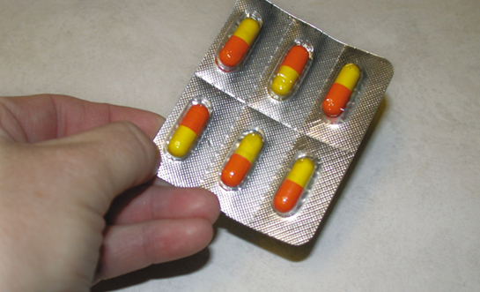
Institutional Pharmacies
Long-term care facilities
Higher level of care than home health care
Some have in-house pharmacy
Some contract with local pharmacy

Slide 24
Terms to Remember
long-term care facility
an institution that provides care for geriatric and disabled patients; includes extended-care facility (ECF) and skilled-care facility (SCF)

Slide 25
Institutional Pharmacies
Managed-care pharmacy services
Encourage health maintenance
Usually have an approved drug list, or formulary
Often have a tiered pricing plan
Lowest price for generic drug
Higher price for “preferred” brand name drug
Highest price for “nonpreferred” brand name drug

Slide 26
Terms to Remember
managed care
a type of health insurance system that emphasizes keeping the patient healthy or diseases controlled in order to reduce healthcare costs
health maintenance organization (HMO)
an organization that provides health insurance using a managed care model

Slide 27
Terms to Remember
formulary
a list of drugs that have been preapproved for use by a committee of health professionals; used in hospitals, in managed care, and by many insurance providers

Slide 28
Institutional Pharmacies
Nuclear pharmacies
Dispense radioactive pharmaceuticals
Require specialized equipment, training, and certifications
Usually located off site

Slide 29
Terms to Remember
nuclear pharmacy
a specialized practice that compounds and dispenses sterile radioactive pharmaceuticals to diagnose or treat disease

Slide 30
The Pharmacist
Evolution of the Pharmacist’s Role
The Role of the Pharmacist
Education and Licensing

Slide 31
Terms to Remember
pharmacist
one who is licensed to prepare and dispense medications, counsel patients, and monitor outcomes pursuant to a prescription from a licensed health professional

Slide 32
Evolution of the Pharmacist’s Role
Four stages in the twentieth century
Traditional era
Scientific era
Clinical era
Pharmaceutical care era

Slide 33
Evolution of the Pharmacist’s Role
Traditional era (pre−World War II)
Focus on natural botanicals
Drugs compounded by pharmacist
Training emphasized pharmacognosy which is the study of medicinal and/or pharmaceutical substances derived from natural sources such as plants, fungi, and animals

Slide 34
Evolution of the Pharmacist’s Role
Scientific era (post−World War II)
Rise of pharmaceutical industry
New drugs synthesized and mass-produced
Pharmacist more of a retailer
Educational focus on pharmacology

Slide 35
Terms to Remember
pharmacology
the scientific study of drugs and their mechanisms of action

Slide 36
Evolution of the Pharmacist’s Role
Clinical era (early 1960s)
Some felt focus had shifted too far toward basic scientific knowledge.
Millis Commission emphasized clinical role of pharmacists.
Profession became more patient-oriented.

Slide 37
Terms to Remember
pharmaceutics
the study of the release characteristics of specific drug dosage forms
pharmacokinetics
individualized doses of drugs based on absorption, distribution, metabolism, and elimination

Slide 38
Terms to Remember
therapeutics
the study of applying pharmacology to the treatment of illness and disease states
pathophysiology
the study of disease and illnesses affecting the normal function of the body

Slide 39
Evolution of the Pharmacist’s Role
Pharmaceutical care era (1990s)
Expanded patient-oriented focus
Updated profession mission to include
Patient counseling
Medication monitoring

Slide 40
Terms to Remember
pharmaceutical care
a philosophy of care that expanded the pharmacist’s role to include appropriate medication use to achieve positive outcomes with prescribed drug therapy

Slide 41
The Role of the Pharmacist
Traditional focus was compounding
Pharmacist now spends more time
Gathering patient information
Advising and informing patients
Monitoring drug interactions and responses
Providing drug information to other healthcare professionals

Slide 42
The Role of the Pharmacist
In addition to dispensing drugs, the community pharmacist
Creates patient care initiatives to identify and prevent disease
Administers immunizations, such as flu shots
Screens and educates patients regarding high blood pressure, diabetes, etc.

Slide 43
The Role of the Pharmacist
The community pharmacist must also be a business person and entrepreneur:
Hires and supervises employees
Manages insurance contracts and claims
Maintains inventories
Sells non-medical merchandise
Manages retail operation

Slide 44
The Role of the Pharmacist
Hospital pharmacist may
Be specialized (pediatric, neonatal, critical care, cancer, etc.)
Advise physicians on appropriate medication use
Be responsible for educating patients about their drugs upon discharge

Slide 45
The Role of the Pharmacist
The hospital pharmacist typically
Provides drug information
Recommends formulary changes
Educates nurses
Develops policies and procedures
Dispenses investigational and hazardous drugs
Maintains inventories

Slide 46
The Role of the Pharmacist
The home healthcare pharmacist may prepare meds and IVs for
Nutrition
Antibiotics
Chemotherapy
Pain management

Slide 47
The Role of the Pharmacist
The pharmacist in long-term care facilities or nursing homes often
Creates recordkeeping systems for controlled substances
Reviews residents’ drug regimens
Monitors handling of on-site drugs
Educates residents regarding drug therapies
Helps ensure regulatory compliance

Slide 48
Education and Licensing for Pharmacists
Doctor of Pharmacy (PharmD)
6-year program
Colleges may require
2 years of prepharmacy education
Pharmacy College Admission Test (PCAT)
On-site interview
Acceptance is extremely competitive
Many students start as pharmacy techs

Slide 49
Education and Licensing for Pharmacist
Pharmacy coursework is challenging:
Basic science courses from several fields
Practice and internships throughout program
Final year spent in practice settings
Hospitals, clinics, and community pharmacies
Home health care and nursing homes

Slide 50
The Pharmacy Technician
Evolution of the Pharmacy Technician’s Role
The Role of the Pharmacy Technician
Education and Licensing

Slide 51
Terms to Remember
pharmacy technician
an individual working in a pharmacy who, under the supervision of a licensed pharmacist, assists in activities not requiring the professional judgment of a pharmacist; also called the pharmacy tech or tech

Slide 52
Evolution of the Pharmacy Technician’s Role
Apprentices were forerunners of today’s pharmacy techs.
Need for techs increased with expanded pharmacist role.
Many techs originally trained as military medics.
Role evolved from clerk/cashier to pharmacist’s assistant.

Slide 53
Evolution of the Pharmacy Technician’s Role
Rather than working independently, the pharmacy technician works under the direction of the supervising pharmacist.

Slide 54
Role of the Pharmacy Technician
A pharmacy tech in a community pharmacy typically
Enters prescription information into database
Helps the pharmacist fill, label, and record prescriptions
Operates cash register
Stocks and inventories medications
Maintains patient records
Bills insurance claims

Slide 55
Role of the Pharmacy Technician
Pharmacy technicians play a valuable role in reducing the risk of medication errors.

Slide 56
Role of the Pharmacy Technician
A pharmacy tech in a hospital setting does many of the same tasks as a tech in a community pharmacy and may also
Operate robotic dispensing machinery
Prepare sterile and sometimes hazardous products

Slide 57
Role of the Pharmacy Technician
A pharmacy tech in a long-term care or nursing home may
Log and refill prescriptions via computer
Maintain drug boxes for emergencies
Package, label, and deliver medications
Maintain records and patient charts
Conduct inspections of drug inventories
Repackage drugs in unit doses

Slide 58
Education and Licensing for Pharmacy Technician
Most state boards of pharmacy regulate
The activities of pharmacy techs
The ratio of pharmacy techs to pharmacists within a pharmacy

Slide 59
Education and Licensing for Pharmacy Technicians
Formal technician training programs have been developed:
In the past, on-the-job training was sufficient.
Original training was hospital-based.
More programs are now developed in community colleges and technical schools.

Slide 60
Education and Licensing for Pharmacy Technicians
In some states, pharmacy techs must be certified to practice:
Many pharmacies require techs to be certified upon hire or soon thereafter.
Some pharmacy employers encourage techs to become certified by
Paying for the certification exam
Giving salary increase to those who pass

Slide 61
Education and Licensing for Pharmacy Technicians
Specialized areas of practice require additional training.
Sterile and nonsterile compounding
Nuclear pharmacy
Some states require ongoing education for the pharmacy tech to keep knowledge and skills current.

